Slide 1
Final Presentation
Studying state-of-the-art HTAP systems
A lecture on HTAP Systems
- Satya Sai Bharath Vemula
- Rwitam Bandyopadhyay
- Shubham Pandey

Slide 2
Table of Contents
Motivation
HTAP Databases
HTAP Techniques

Slide 3
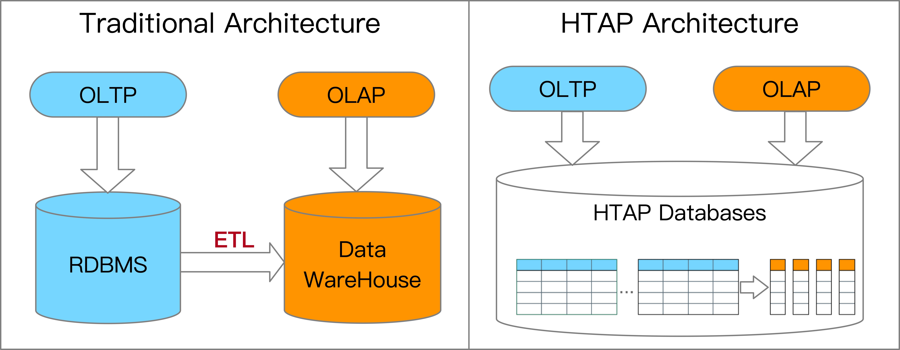
Motivation
Hybrid Transactional and Analytical Processing, HTAP
Gartner’s definition in 2014: utilizes in-memory computing technologies to enable concurrent analytical and transaction processing on the same in-memory data store.
Gartner’s new definition in 2018: supports weaving analytical and transaction processing techniques together as needed to accomplish the business task.
Source: HTAP Databases: What is New and What is Next, SIGMOD '22: Proceedings of the 2022 International Conference on Management of Data

Slide 4




Motivation
Gartner envisioned that, HTAP techniques will be widely adopted in the business applications with real-time data analytics by 2024.
HTAP databases have many applications in E- commerce, Finance and Banking, Fraud Detection, etc.
For example, identify the sales trend on-the-fly in e-commerce; detecting the fraudulent transactions when processing the transactions.
E-commerce
Fraud Detection
Source: HTAP Databases: What is New and What is Next, SIGMOD '22: Proceedings of the 2022 International Conference on Management of Data

Slide 5
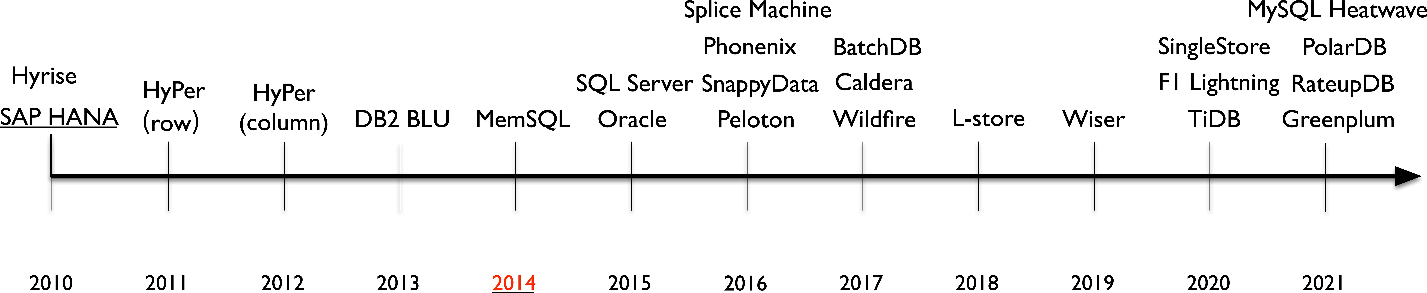
Motivation
Over the last decade, many HTAP databases have emerged
The following timeline consists of three phases:
Phase 1 (2010-2014): HTAP databases mainly adopt primary column store
Phase 2 (2014-2020): HTAP databases mainly extend the primary row store
Phase 3 (2020-present): HTAP databases utilize a distributed architecture
Source: HTAP Databases: What is New and What is Next, SIGMOD '22: Proceedings of the 2022 International Conference on Management of Data

Slide 6
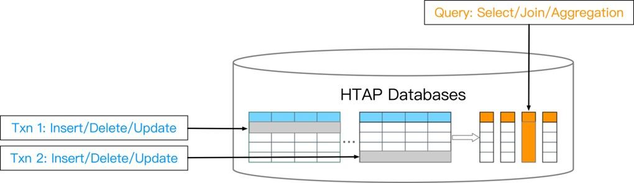
Motivation
Rule of thumb 1: Row store is ideal for OLTP workloads
Row-wise, update-heavy, short-lived transactions
Rule of thumb 2: Column store is best suited for OLAP workloads
Column-wise, read-heavy, bandwidth-intensive queries
We study HTAP databases with both row store and column store
Source: HTAP Databases: What is New and What is Next, SIGMOD '22: Proceedings of the 2022 International Conference on Management of Data

Slide 7
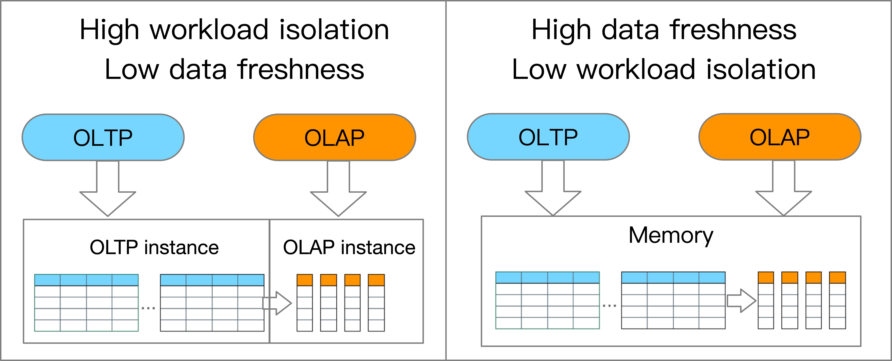
A trade-off for HTAP databases
Workload isolation: the isolation level of handling the mixed workloads
Data freshness: the portion of latest transaction data that is read by OLAP
Trade-off for workload isolation and data freshness
High workload isolation leads to low data freshness
Low workload isolation results in high data freshness
Source: HTAP Databases: What is New and What is Next, SIGMOD '22: Proceedings of the 2022 International Conference on Management of Data

Slide 8
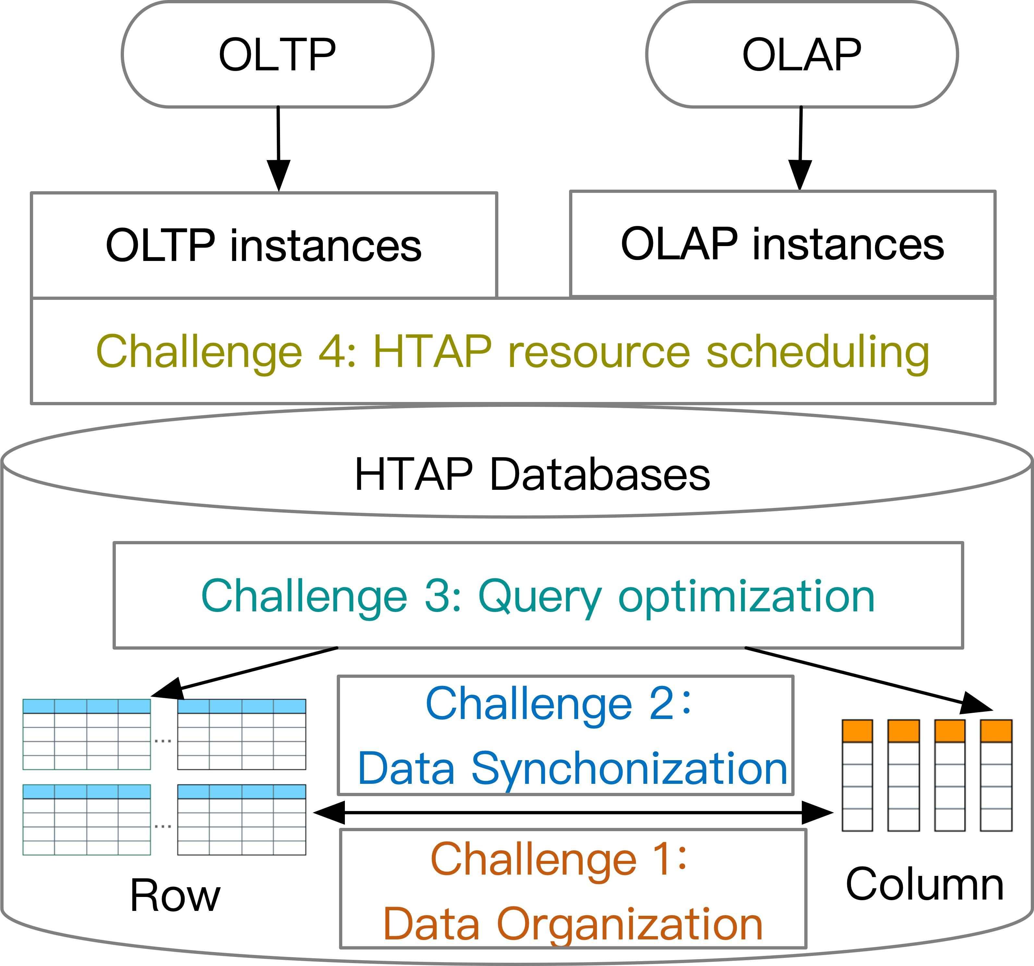
Challenges for HTAP databases
Challenge 1 (Data Organization): how to organize the data adaptively for HTAP workloads with high performance and low storage cost.
Challenge 2 (Data Synchronization): how to synchronize the data from the row store to the column store for high throughput and data freshness
Challenge 3 (Query Optimization): how to optimize the query with both row store and column store by exploring the huge plan space.
Challenge 4 (Resource Scheduling): how to schedule the resources for OLTP and OLTP instances effectively for high throughput and data freshness.
Source: HTAP Databases: What is New and What is Next, SIGMOD '22: Proceedings of the 2022 International Conference on Management of Data

Slide 9
HTAP Databases

Slide 10
An Overview of HTAP Architectures
Primary Row Store + In-Memory Column Store
Distributed Row Store + Column Store Replica
Disk Row Store + Distributed Column Store
Primary Column Store + Delta Row Store
Source: HTAP Databases: What is New and What is Next, SIGMOD '22: Proceedings of the 2022 International Conference on Management of Data

Slide 11
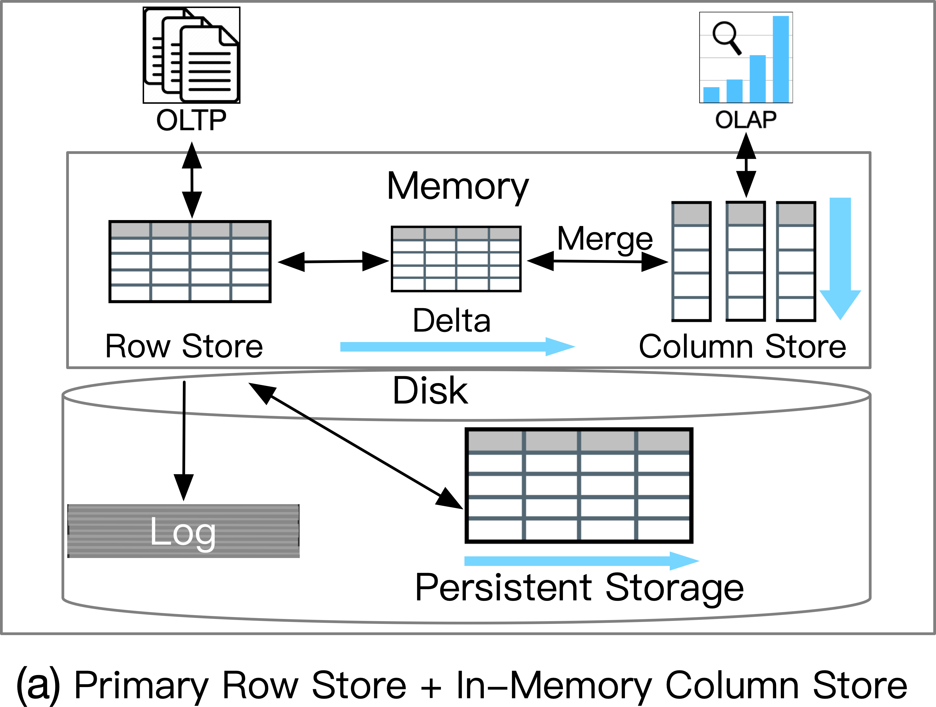
Popular HTAP Architectures
(a) Primary Row Store+ In Memory Column Store
Pros:
High TP throughput,
High AP throughput
High data freshness
Cons:
Low AP scalability
Low workload isolation
Applications:
High throughput, low scalability (e.g., banking with real-time data analytics)
Source: HTAP Databases: What is New and What is Next, SIGMOD '22: Proceedings of the 2022 International Conference on Management of Data

Slide 12
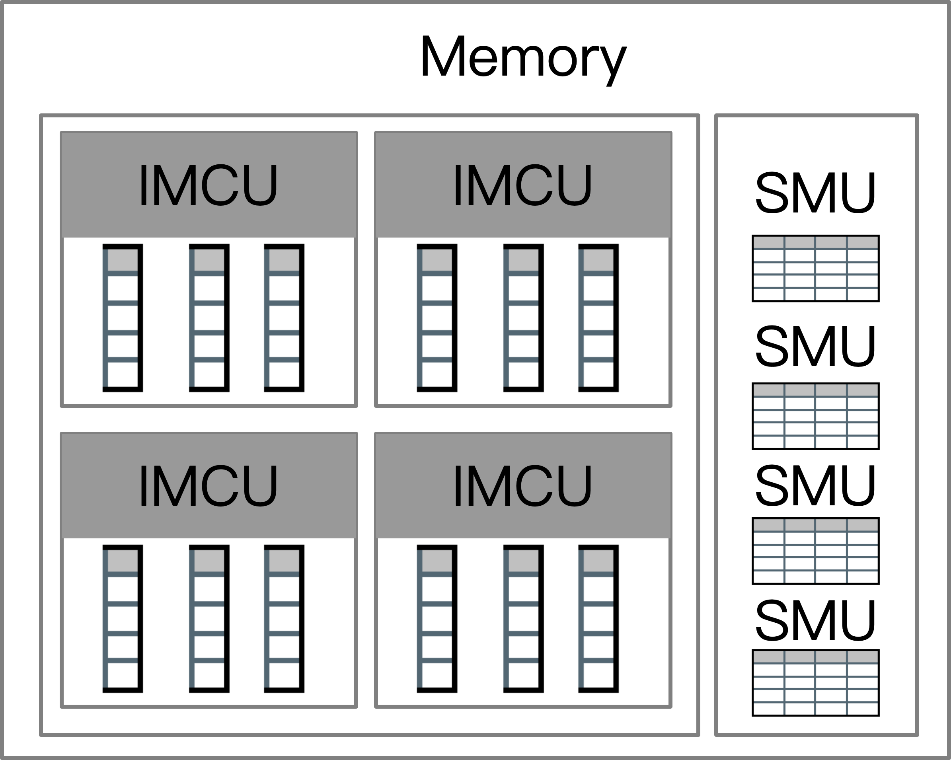
An Overview of HTAP Architectures
Case Study: Oracle Dual-Format
Oracle Snapshot Memory Unit (SMU)
Oracle In-memory column store (IMCS)
Oracle Cache
Oracle Disk-based Row Store
Source: HTAP Databases: What is New and What is Next, SIGMOD '22: Proceedings of the 2022 International Conference on Management of Data

Slide 13
Challenges for HTAP Databases with architecture (a)
Problems: need to increase the AP scalability and workload isolation
Challenges: how to scale and isolate the AP (i.e., column store) while maintaining high TP & AP throughput and data freshness
Possible ways:
Scale up/out the memory capacity
Source: HTAP Databases: What is New and What is Next, SIGMOD '22: Proceedings of the 2022 International Conference on Management of Data

Slide 14
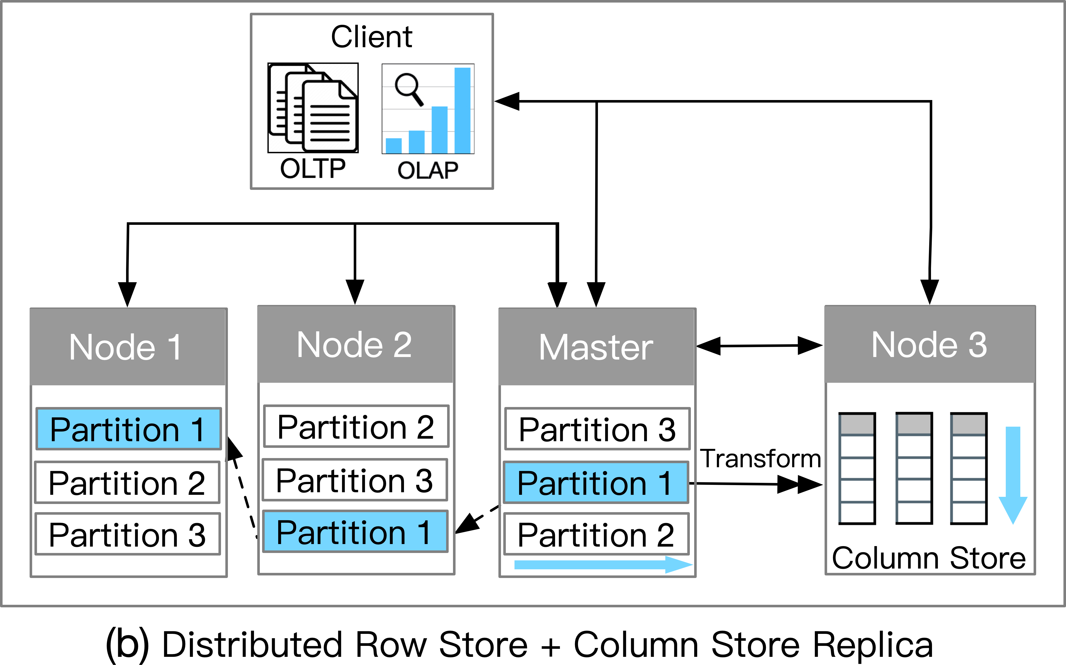
Popular HTAP Architectures
(b) Distributed Row Store + Column Store Replica
Pros:
High workload isolation
High scalability
Cons:
Low data freshness
Applications:
High TP & AP scalability, tolerable data freshness (e.g., E-commerce with real-time data analytics)
Source: HTAP Databases: What is New and What is Next, SIGMOD '22: Proceedings of the 2022 International Conference on Management of Data

Slide 15
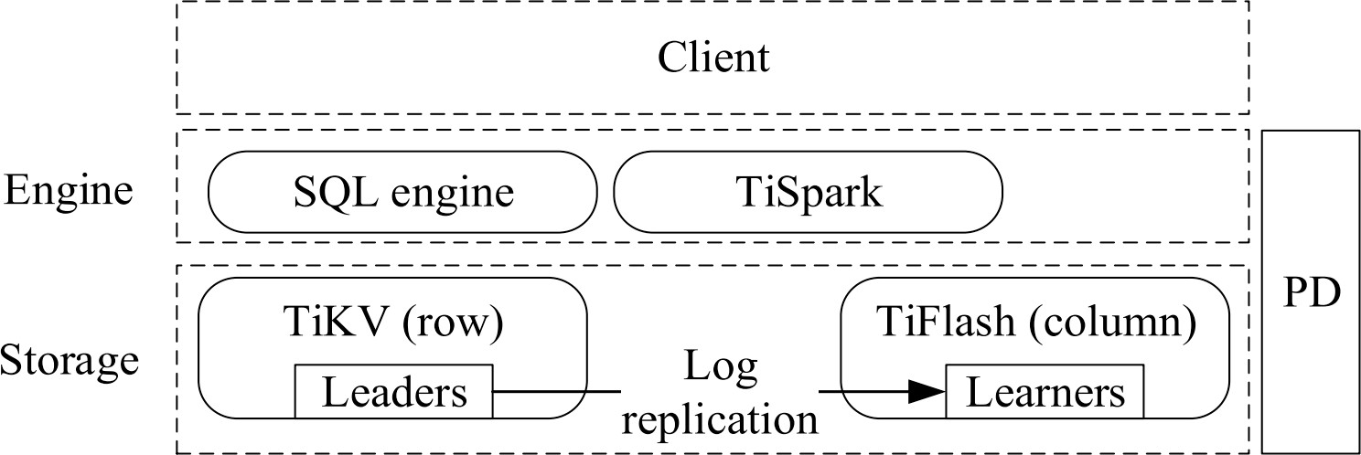
An Overview of HTAP Architectures
Case Study: TiDB
2PC+Raft for TP
Cost-based query processing for AP
TiKV nodes (Leader and Follower)
TiFlash nodes (Learner)
Asynchronously Log-based replay+ column delta tree
Source: HTAP Databases: What is New and What is Next, SIGMOD '22: Proceedings of the 2022 International Conference on Management of Data

Slide 16
Challenges for HTAP Databases with architecture (b)
Problems: need to increase the data freshness
Challenges: how to efficiently merge the delta files to the column store
Possible solutions:
Memory-based delta logging and shipping
New indexing techniques for delta merging
Source: HTAP Databases: What is New and What is Next, SIGMOD '22: Proceedings of the 2022 International Conference on Management of Data

Slide 17
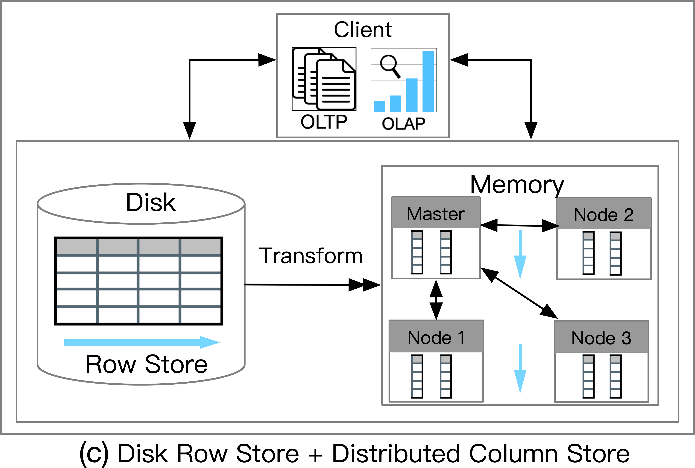
Popular HTAP Architectures
(c) Disk Row Store + Distributed Column Store
Pros:
High workload isolation
High AP throughput and scalability
Cons:
Medium(On-premise)/Low(Cloud-based) data freshness
Applications:
High AP scalability, tolerable data freshness (e.g., IoT applications with real-time data analytics)
Source: HTAP Databases: What is New and What is Next, SIGMOD '22: Proceedings of the 2022 International Conference on Management of Data

Slide 18
Challenges for HTAP Databases with architecture (c)
Problems: need to increase the data freshness and reduce the storage cost
Challenges: how to balance the data freshness AP throughput, and storage cost adaptively
Possible solutions:
Cost models for column data management
Source: HTAP Databases: What is New and What is Next, SIGMOD '22: Proceedings of the 2022 International Conference on Management of Data

Slide 19
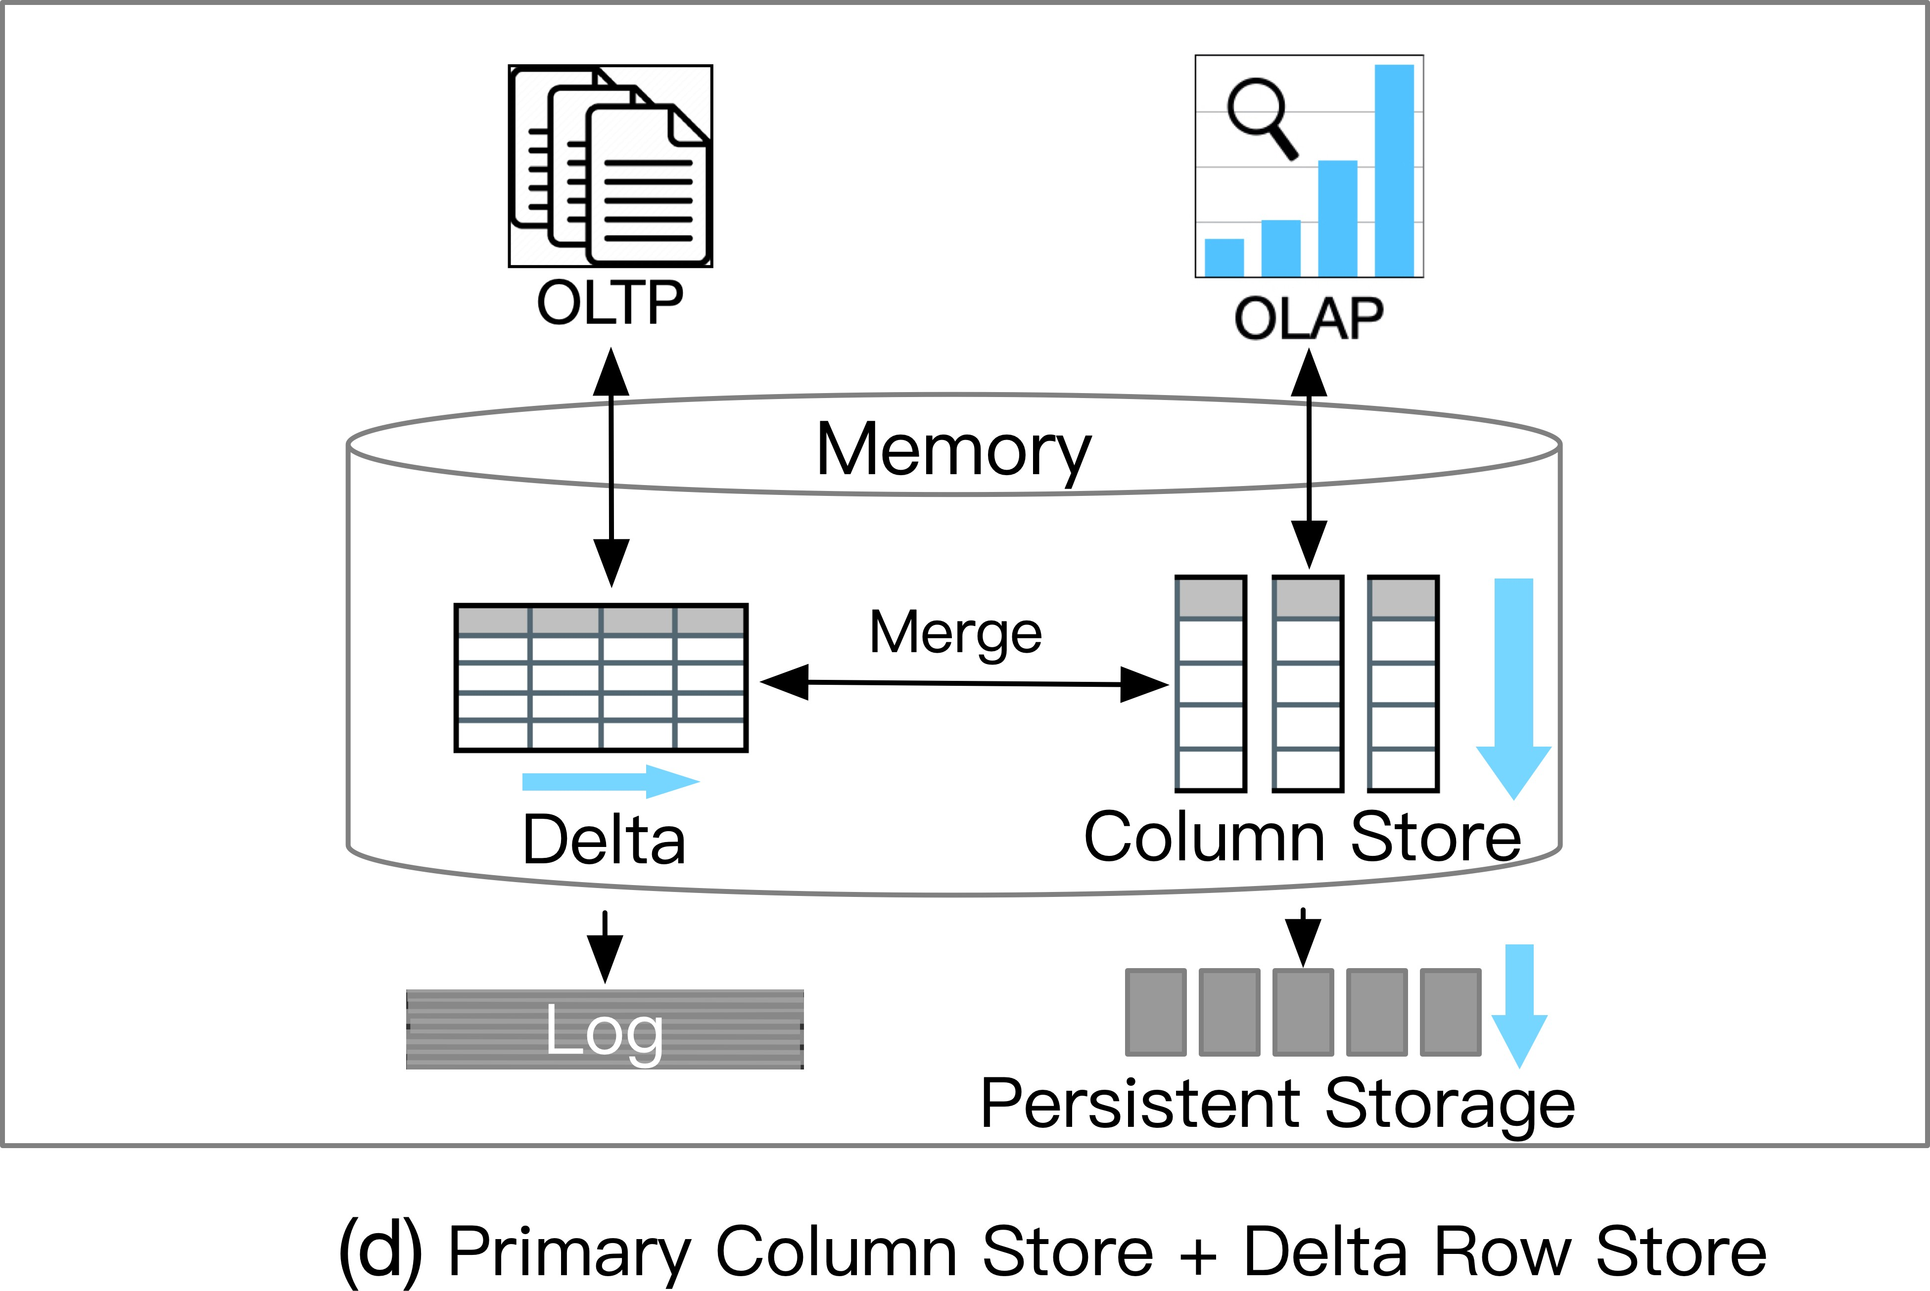
Popular HTAP Architectures
(d) Primary Column Store + Delta Row Store
Pros:
High data freshness
High AP throughput
Cons:
Low TP scalability
Low workload isolation
Applications:
High AP throught, High data freshness (e.g., Real-time Fraud Detection)
Source: HTAP Databases: What is New and What is Next, SIGMOD '22: Proceedings of the 2022 International Conference on Management of Data
Notes:
In this last architecture, the column store is actually the primary storage and is basis for OLAP, Whereas the OLTP is handled by delta row store and it can be implemented in different ways that I will talk about in a while when I specifically discuss transaction processing. Note that columnar storage is highly read optimized and the process of merging is efficient, that allows high data freshness and high AP throughput. I will also talk about the Cons when I discuss the challenges with this architecture.

Slide 20
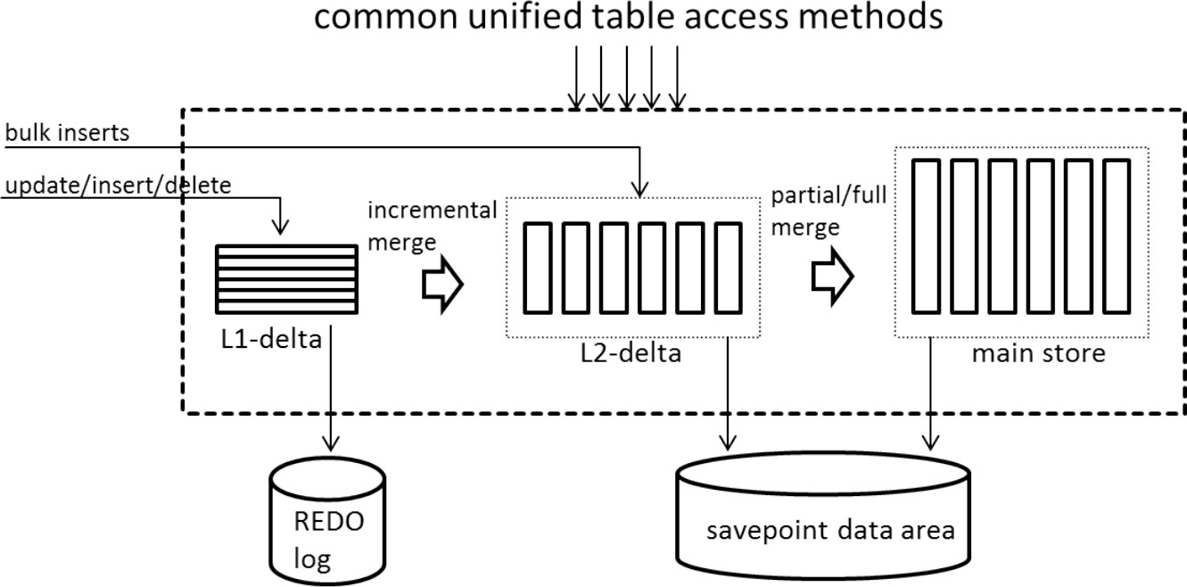
An Overview of HTAP Architectures
Case Study: SAP HANA
L1 Cache (Row)
Column Store
Global Dictionary
Local Dictionary
L2 Cache
(Column)
Source: HTAP Databases: What is New and What is Next, SIGMOD '22: Proceedings of the 2022 International Conference on Management of Data
Notes:
Lets take a look at the representative architecture, like SAP HANA. It divides the in-memory data store into three layers: L1-delta, L2-delta, and Main. The L1-delta keeps data updates in a row-wise format. When the threshold is reached, the data in L1- delta is appended to L2-delta while also maintaining local dictionary to facilitate column store management. The L2-delta transforms the data into columnar data, then merges the data into the main column store and adds information to the global dictionary. Finally, the columnar data is persisted to the disk storage.

Slide 21
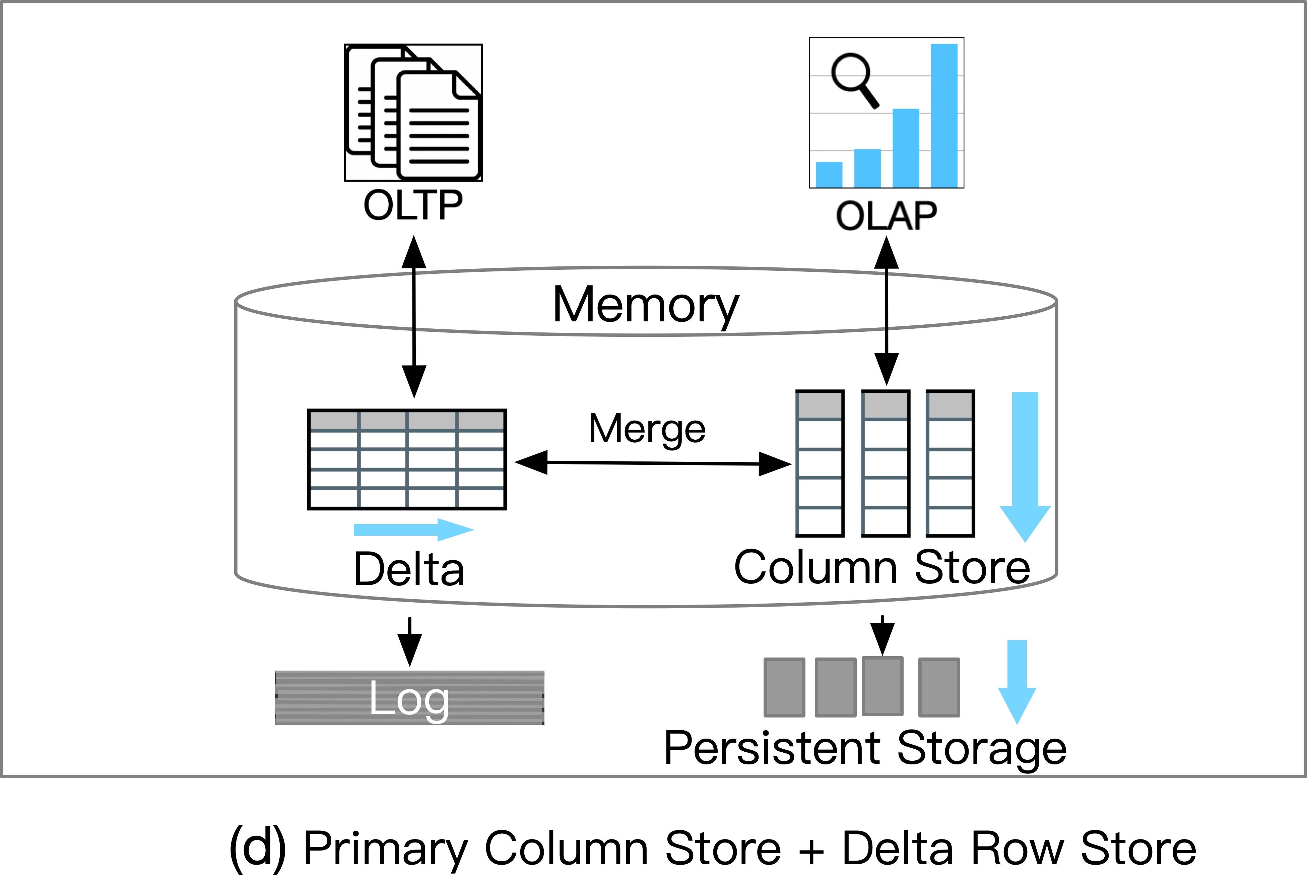
Challenges for HTAP Databases with architecture (d)
Problems:
Need to increase the TP scalability
Need to increase workload isolation
Challenge: How to traverse the delta storage efficiently while keeping high throughput for HTAP
Possible solutions:
Trade data freshness for AP throughput
New Indexing techniques for delta traversal and delta merging
Source: HTAP Databases: What is New and What is Next, SIGMOD '22: Proceedings of the 2022 International Conference on Management of Data
Notes:
As we have seen earlier, one challenge is the TP scalability because of the delta row stores and how the data is appended with the incoming updates, this leads to large number of small files thereby impacting scalability. We also saw that this architecture provides high freshness which means we are compromising the isolation because for updates to reflect fast, two workloads manipulating the data cannot be fully isolated.
So if we want to have efficiency in both OLTP and OLAP workloads, one possible solution can be to let go of the data freshness a bit and improve the AP throughput, or applying indexes on delta row store and use them in delta merging techniques as well.

Slide 22
A summary of HTAP databases
Category | HTAP Databases | OLTP Throughput | OLAP Throughput | OLTP Scalability | OLAP Scalability | Workload Isolation | Data Freshness
Primary Row Store+ In Memory Column Store | Oracle Dual-Format SQL Server, DB2 BLU | High | High | Medium | Low | Low | High
Distributed Row Store + Column Store Replica | TiDB, F1 Lightning SingleStore | Medium | Medium | High | High | High | Low
Disk Row Store + Distributed Column Store | MySQL Heatwave, Oracle RAC | Medium | Medium | Medium | High | High | Medium
Primary Column Store + Delta Row Store | SAP HANA (without scale-out), Hyper | Medium | High | Low | Medium | Low | High
Source: HTAP Databases: What is New and What is Next, SIGMOD '22: Proceedings of the 2022 International Conference on Management of Data
Notes:
This is the summary of all the 4 architectures, but the intention of this discussion is to actually look at some interesting tradeoffs.
looking at architecture 1 , which is the first row, we can observe that it has high throughput, but has low scalability. The reason for this is that it uses a single system. And naturally this ensures data freshness because we do not have to bring the updates from any other machine but it suffers from low workload isolation.
In contrast, the second architecture which is distributed has high scalability owing to its distributed nature, but takes a hit in the freshness and throughput for the workloads.
<Rwitam speaks about the 3 rd row>

Slide 23
HTAP Techniques
Notes:
Now lets talk about key techniques adopted by state-of-the-art HTAP databases. And yes, they do have pros and cons concerning various metrics like efficiency, scalability and freshness.

Slide 24
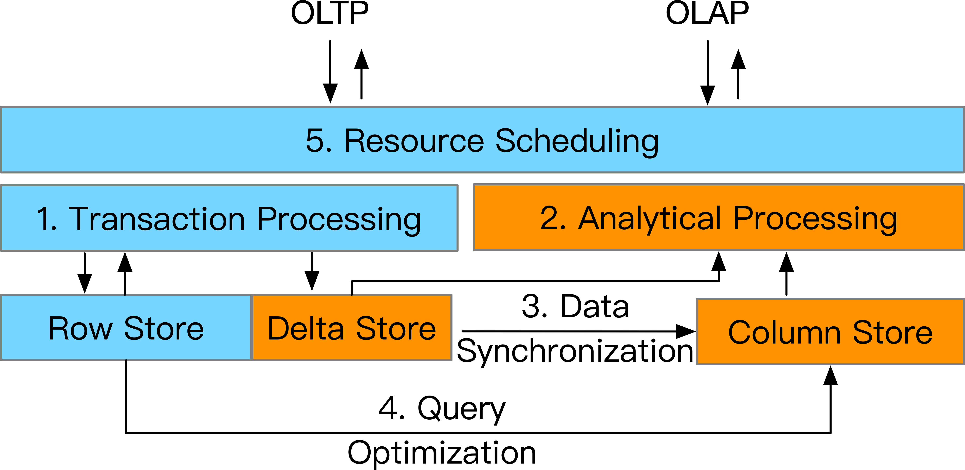
Overview of HTAP Techniques
Transaction Processing: updating the row store and writing the delta store
Analytical Processing：scanning the column store with delta store
Data Synchronization: merging the delta data to column store
Query Optimization: planning queries against row store and column store
Resource Scheduling: scheduling resources for OLTP and OLAP instances
Source: HTAP Databases: What is New and What is Next, SIGMOD '22: Proceedings of the 2022 International Conference on Management of Data
Notes:
These are the 5 techniques and the figure below shows where they fit in the HTAP htap systems. For example we have resource scheduling at the very top that is involved in allocation of resources for OLTP and OLAP instances. We have Transaction and analytics processing as two separate units in HTAP systesms, and data synchronization when the data is moved from primary to secondary storage, and we also have query optimization which requires planning of queries against both row and column store.

Slide 25
Transaction Processing
Standalone Transaction Processing with In-Memory Delta Update
Standalone transaction processing with MVCC protocol
In-memory delta update for insert/delete/update operations
E.g., Oracle, SQL Server, SAP HANA
Distributed Transaction Processing with Log Replay
Raft protocol for distributed TP and data replication
Log replay for updating the row store and column store
E.g., F1 Lightning, TiDB
Master-slave replication for distributed TP, e.g., Singlestore
Source: HTAP Databases: What is New and What is Next, SIGMOD '22: Proceedings of the 2022 International Conference on Management of Data
Notes:
Lets talk about transaction processing in a little more detail.
Depending on the architecture, there are two main techniques applied for transaction processing. The first one uses MVCC protocol and the second one uses Raft protocol. And I will discuss each one of these in the upcoming slides

Slide 26
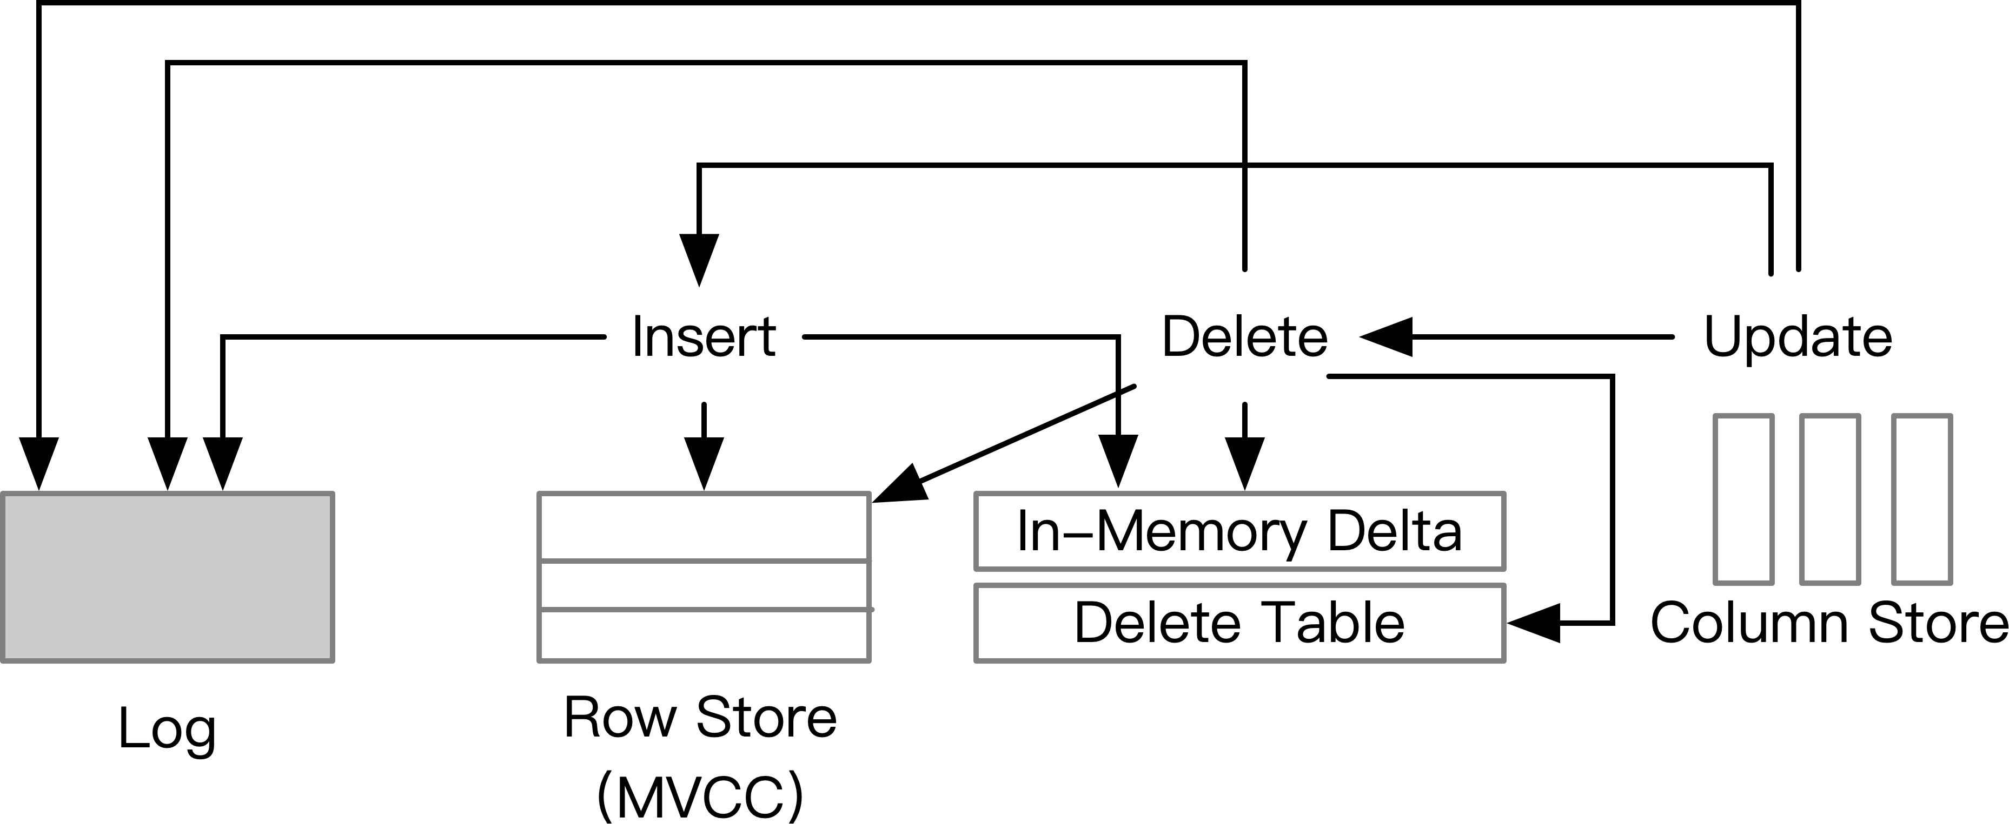
Transaction Processing
1. Standalone TP for insert/delete/update operations
(1)
(1)
(1)
(3)
(2)
(2)
(2)
(3)
(4)
Source: HTAP Databases: What is New and What is Next, SIGMOD '22: Proceedings of the 2022 International Conference on Management of Data
Notes:
Lets talk about the first method.
For updating the in memory data store, the procedure is as follows
For insertion, it writes to the log and updates the row store using MVCC protocol. On a high level you can think of MVCC protocol as something that allows multiple copies of data so that data can be safely read and updated at the same time.
and then inserts the tuple to in memory delta store
For deletes, it writes to the log, performs delete operation in row store, then delete tuple in delta row store and if the target tuple has also been insereted in the column store then it marks such deletion in the delete table which is normally implemented by a bitmap
For updates, it simply converts it to sequnce of insert and delete.

Slide 27
Transaction Processing
Three implementations for an in-memory delta store:
Heap table
Index organized table
L1 cache
Delta Store | Databases | Pros | Cons
Heap table | Oracle | Fast Insertion | Slow Lookup
Index Organized Table | SQL Server | Fast Lookup | Slow Insertion
L1 Cache | SAP HANA | Fast Insertion | Slow Lookup Low Capacity
Source: HTAP Databases: What is New and What is Next, SIGMOD '22: Proceedings of the 2022 International Conference on Management of Data
Notes:
Since delta store is used in facilatiting Transaction Processing, lets look at different ways in which it can be implemented.

Slide 28
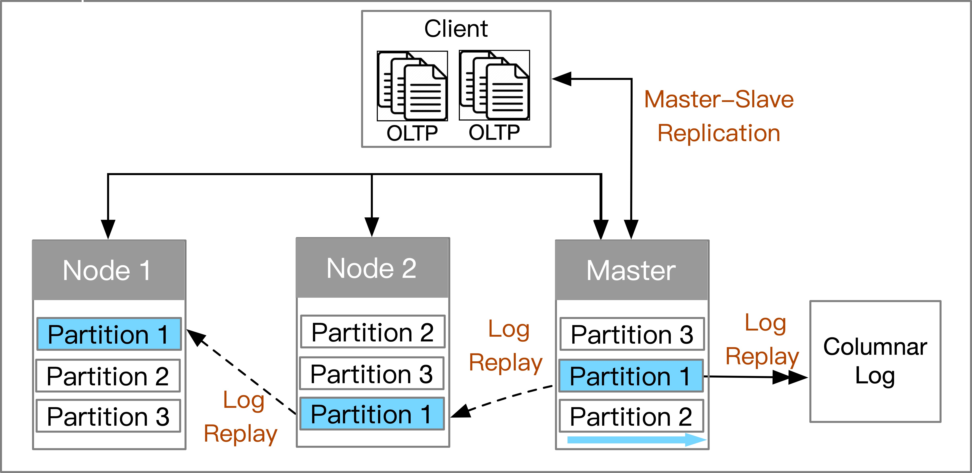
Transaction Processing
Distributed Transaction Processing with Log Replay​ (1)
Master-slave replication
Master node handles the transactions, then replicate the logs to slave nodes
E.g., SingleStore
Source: HTAP Databases: What is New and What is Next, SIGMOD '22: Proceedings of the 2022 International Conference on Management of Data
Notes:
For distributed TP with log replay, the simple way is to use master slave replication. Master node handles all the OLTP transactions, and the logs at master nodes shipped to replicas where they replayed to get in sync.

Slide 29
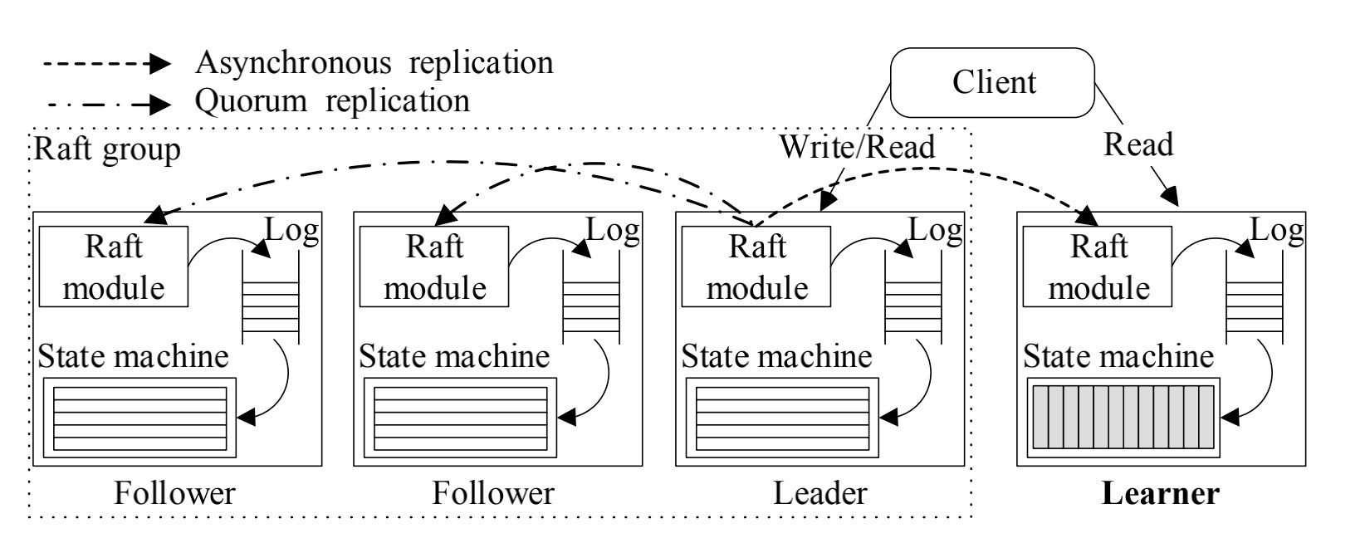
Transaction Processing
Distributed Transaction Processing with Log Replay​ (2)
Modified Raft Protocol for TP and AP nodes
Leader (row), Follower (row), Learner (column)
Source: HTAP Databases: What is New and What is Next, SIGMOD '22: Proceedings of the 2022 International Conference on Management of Data
Notes:
As far as Transaction processing is concerned, we only need to pay attention to the cluster of nodes inside this rectangle. It runs the raft algorithm to elect leader, and the leader is responsible to taking all the client OLTP requests.
Once the leader gets a request, it appends entry to its log, and then it replicates this to the followers, the followers store it but do not apply to the state machine yet, the leader keeps track of the followers that have added this log, and notifies all the followers once a quorom is reached, the leader notifies all the followers and they apply the log to their state machine. This ensures strong consistency.

Slide 30
Comparisons of TP techniques in HTAP Databases
Transaction Processing Type | Databases | TP Techniques | Delta | Pros | Cons
Standalone TP + In-memory Delta Update | Oracle, SQL Server | MVCC | In-Memory Delta | High Efficiency | Low Scalability
Distributed TP + Log Replay | SingleStore | Master-Slave Replication | Log Files | High Efficiency | Low Freshness
 | TiDB, F1 Lightning | 2PC+Paxos | Log Files | High Scalability | Low Efficiency
Source: HTAP Databases: What is New and What is Next, SIGMOD '22: Proceedings of the 2022 International Conference on Management of Data
Notes:
In-memory delta update: This technique involves storing only the changes made to the database (delta) in memory, rather than storing the entire database. This results in high efficiency because only the changed data needs to be processed, but it also limits scalability because the memory requirements increase with the size of the database.
Now if we compare the last two rows, we can see that log replay technique is efficient because as soon as the master node applies the update, it acknowledges back , but this also means low freshness because the replica nodes take apply the updates asynchronously. In contrast to this, when we use Paxos or Raft, it ensures strong consistency
Log replay: This technique involves replicating the log files from the master database to the slave databases, and then replaying the log files to update the slave databases. This results in high efficiency because only the log files need to be processed, but it also limits freshness because there may be a delay between the time the changes are made in the master database and the time they are replicated to the slave databases.
Lightning: This technique involves using 2-phase commit with Paxos to ensure consistency across multiple nodes in a distributed database system. This results in high scalability because it allows for a large number of nodes to participate in the database system, but it also limits efficiency because the 2-phase commit protocol can be time-consuming and resource-intensive.

Slide 31
Analytical Processing
Standalone Columnar Scan with In-Memory Delta Traversing
Single Instructions Multiple Data (SIMD), Vector Processing
In-Memory Delta Traversing
E.g., Oracle, SQL Server
Distributed Columnar Scan with Log File Scanning
Distributed Query Processing over Columnar Segments
Disk-based Log Files Merging and Scanning
E.g., F1 Lightning, TiDB
Source: HTAP Databases: What is New and What is Next, SIGMOD '22: Proceedings of the 2022 International Conference on Management of Data
Notes:
RWITAM
Analytical processing techniques can be broadly classified into two categories.
The first one relies on in-memory columnar stores
The second category features distributed query processing over columnar segments.

Slide 32
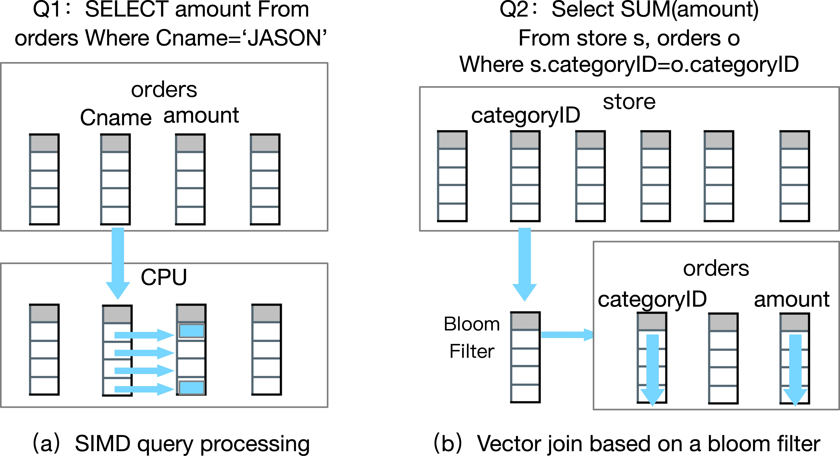
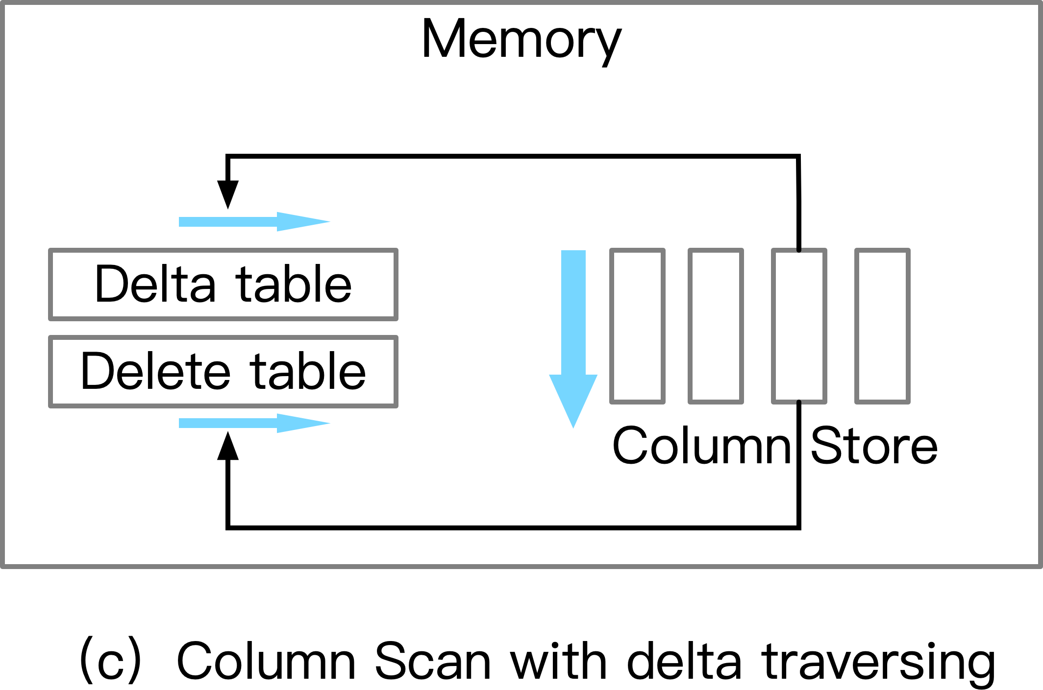
Analytical Processing
1. Standalone Columnar Scan with In-Memory Delta Traversing
Fetch visible values in the delta table and skip stale data in the delete table
Source: HTAP Databases: What is New and What is Next, SIGMOD '22: Proceedings of the 2022 International Conference on Management of Data
Notes:
RWITAM
1st example
Queries can utilize SIMD which can help evaluate bulk values in one CPU instruction.
2nd example
Consider a query which aggregates values over multiple stores. This query is reduced to a vector scan over catgoryID column. Then it builds a bloom filter, then addition vector scans over additional columns utilize the bloom filter.
3rd example
While fetching hot data from delta tables, we can also refer to delete table to identify the values which have been logically deleted from the row store, and then skip them.

Slide 33
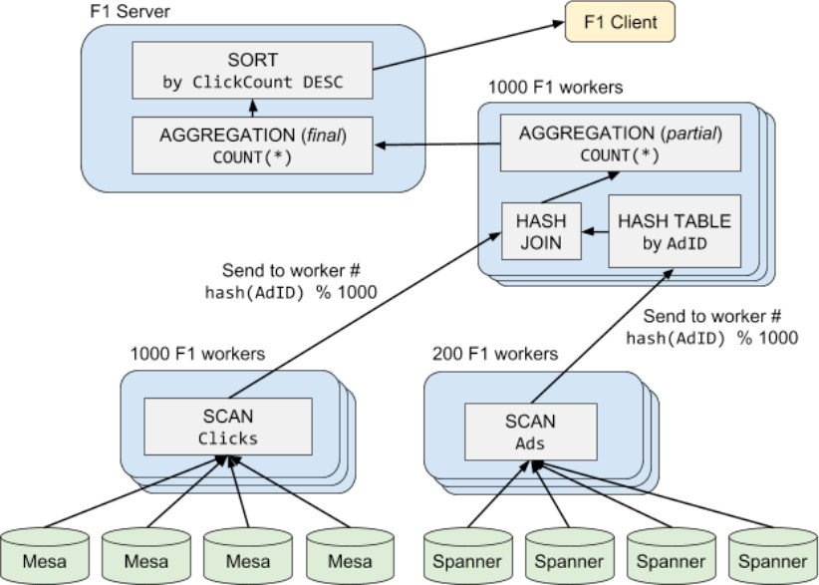
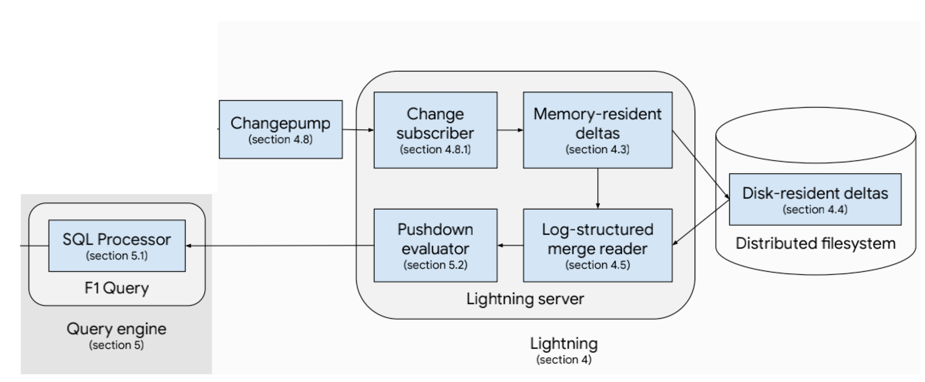
Analytical Processing
2. Distributed Columnar Scan with Log File Scanning
Distributed Columnar Scan
Log File Scanning
Source: HTAP Databases: What is New and What is Next, SIGMOD '22: Proceedings of the 2022 International Conference on Management of Data
Notes:
RWITAM
2nd approach would be distributed columnar scan with log file scanning.
For example, F1 Lightning utilizes a bottom-up approach in it’s query optimizer.
For a query touching 2 tables, click table, ads table.
The engine assigns 1000 workers to Clicks table and 200 workers to ads table.
Then it performs a Hash Join between all the values, and returns the aggregation data to the client.
Moreover, to access the latest data, Lightning server will merge memory resident and disk resident data using LSM trees and utilizes distributed query processing.

Slide 34
Comparisons of AP techniques in HTAP Databases
Analytical Processing Type | Databases | AP techniques | Delta | Pros | Cons
Standalone Columnar Scan + In-Memory Delta Traversing | Oracle, SQL Server, SAP HANA | Vector query processing + Delta traversing | In-memory delta table | High Freshness | Large Memory Size
Distributed Columnar Scan + Log File Scanning | TiDB, F1 Lightning | Distributed query processing + Log scanning | Disk-based log files | High Scalability | Low Efficiency
Source: HTAP Databases: What is New and What is Next, SIGMOD '22: Proceedings of the 2022 International Conference on Management of Data

Slide 35
Data Synchronization
Periodically merge the latest transaction data to the column store
Type 1: In-memory delta merge
Threshold-based merging
Two-phase data migration
Dictionary-based migration
Oracle, SQL Server, SAP HANA
Type 2: Log-based delta merge
LSM-tree and B-tree
TiDB, F1 Lightning
Source: HTAP Databases: What is New and What is Next, SIGMOD '22: Proceedings of the 2022 International Conference on Management of Data

Slide 36
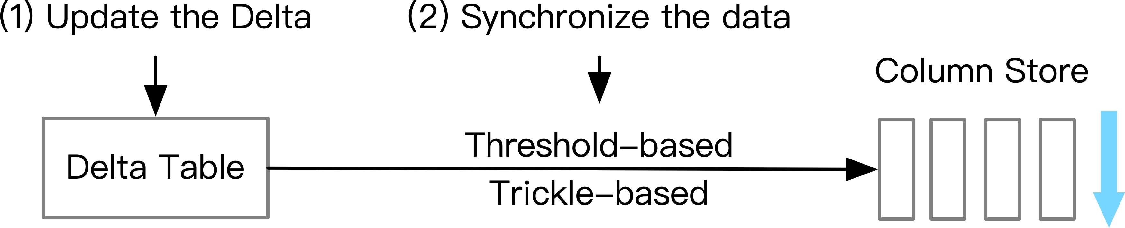
Data Synchronization
In-Memory Delta Merging
Method 1: Threshold-based merging
e.g., threshold reaches 90% of column store
(a) Threshold-based merging
Source: HTAP Databases: What is New and What is Next, SIGMOD '22: Proceedings of the 2022 International Conference on Management of Data

Slide 37
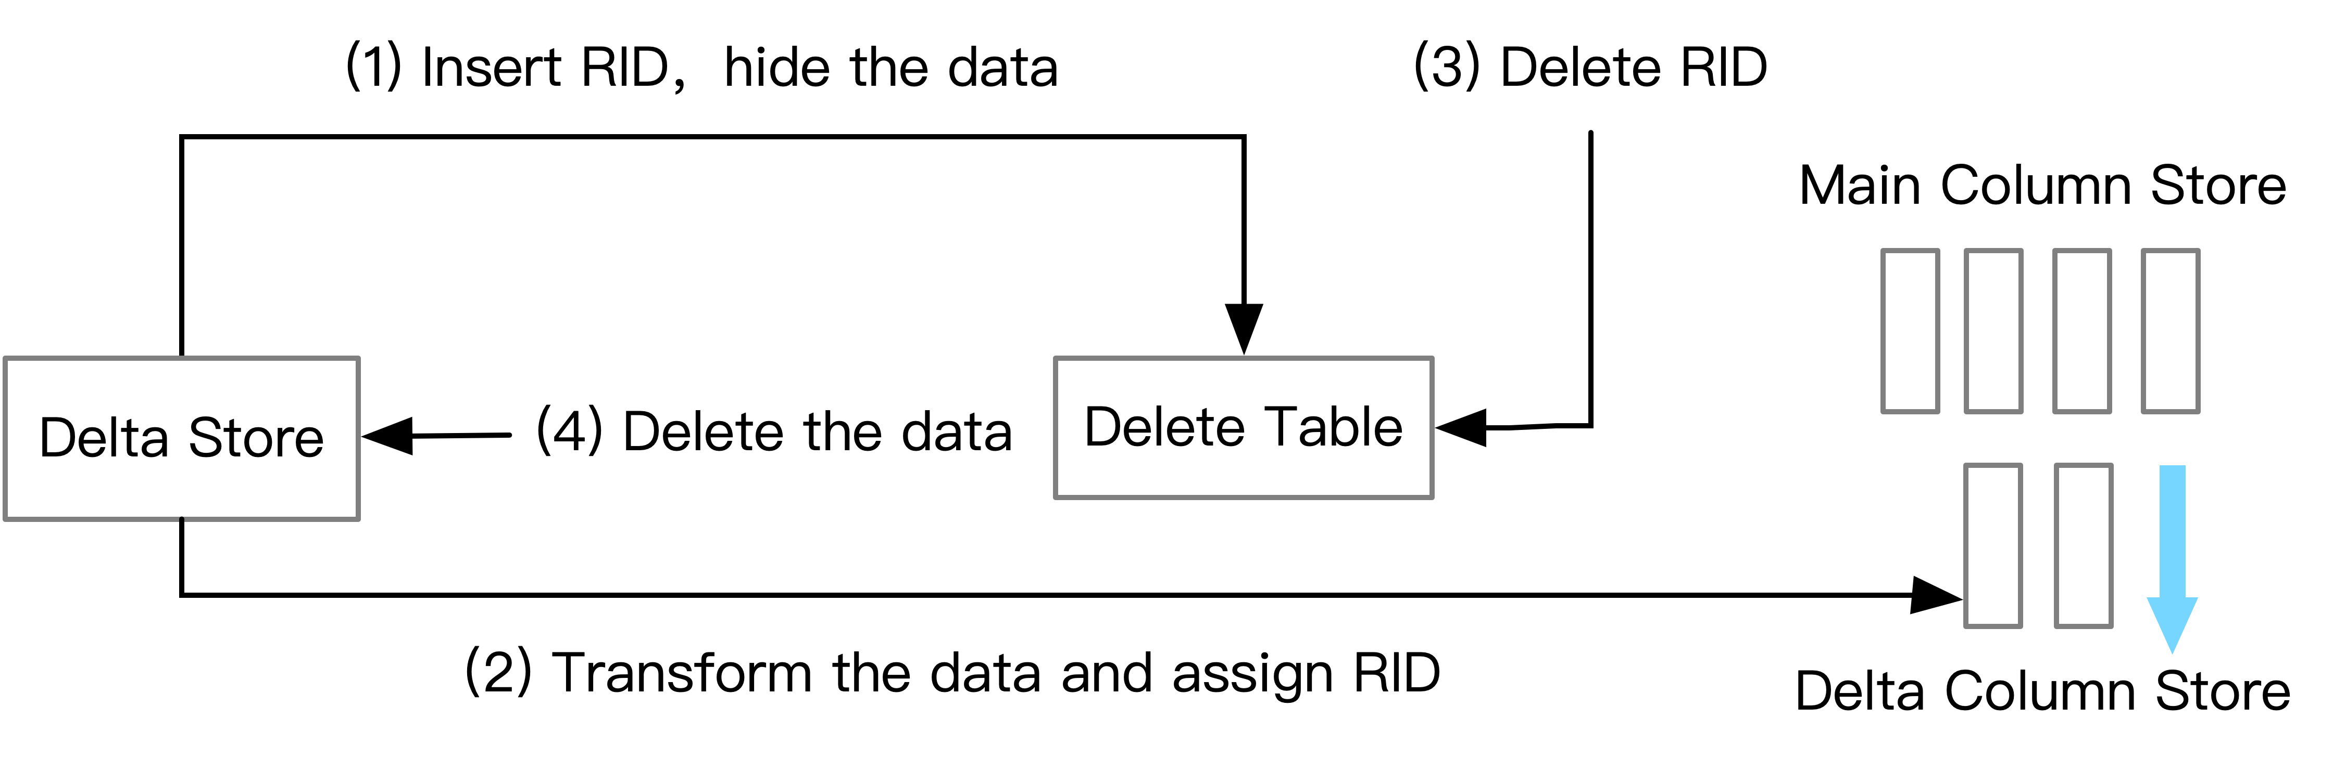
Data Synchronization
In-Memory Delta Merging
Method 2: Two-phase delta migration
Phase 1: Preparation on migration
Phase 2: Operation on migration
(b) Two-phase data migration
Source: HTAP Databases: What is New and What is Next, SIGMOD '22: Proceedings of the 2022 International Conference on Management of Data

Slide 38
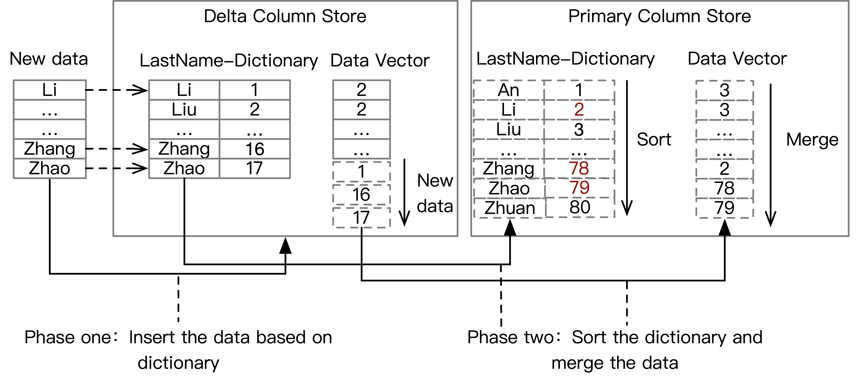
Data Synchronization
In-Memory Delta Merging
Method 3: Dictionary-based merging
(c) Dictionary-based merging
Source: HTAP Databases: What is New and What is Next, SIGMOD '22: Proceedings of the 2022 International Conference on Management of Data

Slide 39
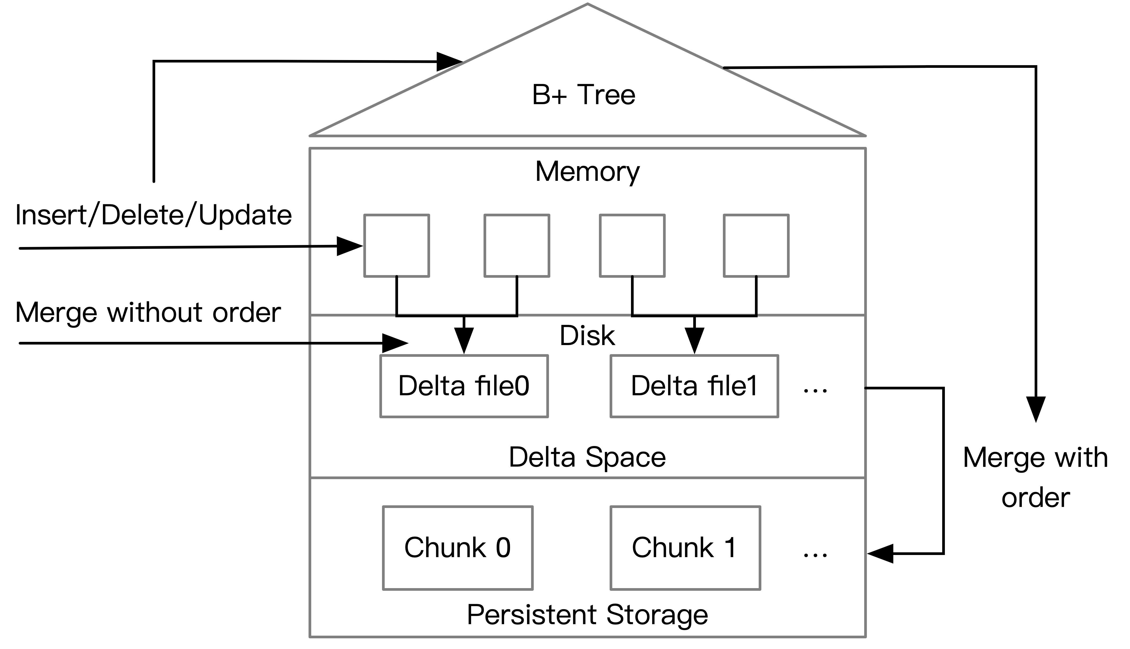
Data Synchronization
Log-based delta merge
Memory-resident deltas (row-wise)
Disk-resident deltas (column-wise)
Merging and Collapsing
B+-Tree for fast merging
Source: HTAP Databases: What is New and What is Next, SIGMOD '22: Proceedings of the 2022 International Conference on Management of Data

Slide 40
Comparisons of DS techniques in HTAP Databases
Data Synchronization | Databases | DS techniques | Pros | Cons
In-Memory delta merge | Oracle, SQL Server, SAP HANA | Threshold-based merging Two-phase delta migration Dictionary-based merging | High Efficiency | Low Scalability
Log-based delta merge | TiDB, F1 Lightning | Multi-level deltas B+tree Log merging | High Scalability | High Merge Cost
Source: HTAP Databases: What is New and What is Next, SIGMOD '22: Proceedings of the 2022 International Conference on Management of Data

Slide 41
Project Summary
Milestone 1
Oracle Dual Format
Milestone 2
PolarDB
SingleStore
Greenplum DB
SAP HANA
TiDB
Final Presentation
Snappy Data
VoltDB
DB2 BLU
HTAP Overview
Milestone 3

Slide 42
Thank YOu

